Slide 1

ART GALLERY MANAGEMENT SYSTEM

Slide 2

Project title
ART GALLERY MANAGEMENT SYSTEM
An art gallery management system is a software application that helps streamline the process of managing an art gallery.

Slide 3
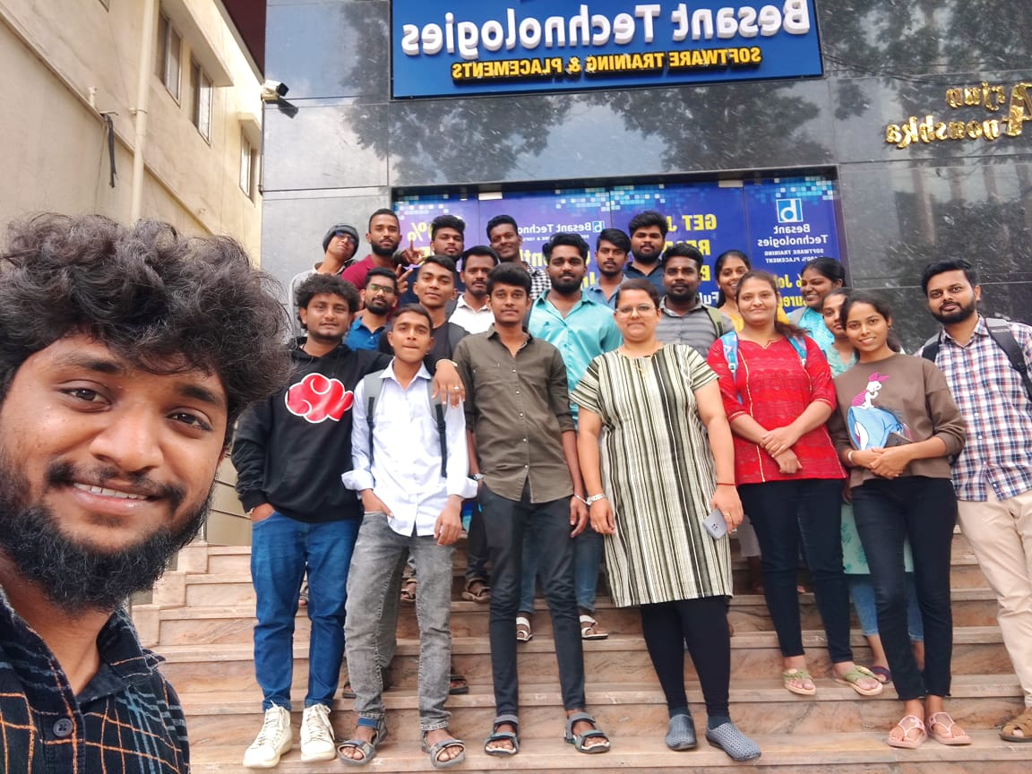
KNOWLEDGEMENT
I would like to extend my sincere thanks/gratitude to our Besant Technology for providing such a conduive environment and platform for us with which we’ve been able to accomlish this project.
Also, our teacher PRIYANKA ma’am for passing such knowledge to us in a very good and understandind way. My classmate for helping and supporting me out where i needed it.

Slide 4

INTRODUCTION
ART GALLERY MANAGEMENT SYSTEM IS A SOFTWARE APPLICATION DESIGNED TO STREAMLINE THE PROCESS OF MANAGING AN ART GALLERY. THE SYSTEM PROVIDES A CENTRALIZED DATABASE FOR STORING INFORMATION ON ARTIST, ARTWORK, EXHIBITIONS AND SALES. THE SOFTWARE INCLUDES TOOLS FOR TRACKING GALLERY INVENTORY, CREATING MARKETING MATERIALS AND MANAGING CUSTOMER RELATIONSHIP. THE SYSTEM IS DESIGNED TO BE USER-FRIENDLY AND CAN BE ACCESSED FROM ANY INTERNET-CONNECTED DEVICE.
ONLINE ART GALLERY IS AN ONLINE APPLICATION, WHICH IS USED TO DISPLAY AND SELL ART WORK OF ARTIST IRRESPECTIVE OF THEIR NATIONALITY, GENDER AND OTHER NARROW CONSDERATION,THROUTH AUCTION. ARTIST CAN REGISTER ONLINE FORBEING A MEMBER IN THE ART GALLERY AND EACH ARTIST CAN UPLOAD THE DIGITAL COPY OF THEIR ART WORK UNDER THE RESPECTIVE CATEGORIES.

Slide 5
OBJECTIVE OF THE PROJECT
TO MANAGE THE DETAILS OF GALLERY, EXHIBITION, ARTWORK AND ARTIST. IT MANAGES ALL THE SALES AND INTENTIRY IN THE GALLERY. THE PURPOSE OF THE PROJECT IS TO BUILD AND APPLICATION PROGRAM TO REDUCE THE MANNUAL WORK.
TO MAINTAINS THE RECORD OF EXHIBITIONS AND VARIOUS SALES MADE DURING IT. THE OBJECTIVE OF DEVELOPING SUCH COMPUTIZED SYSTEM IS TO REDUCE THE PAPER WORK AND SAFE OF TIME IN ART GALLERY DATABASE MANAGEMENT, THEREBY INCREASING THE EFFICIENCY AND DECREASING THE WORK LOAD.
TO DEVELOP SUCH COMPUTERIZED SYSTEM IS TO REDUCE THE PAPER WORK AND SAFE OF TIME IN ART GALLERY DATABASE MANAGEMENT, THEREBY INCREASING THE EFFICIENCY AND DECREASING THE WORK LOAD.

Slide 6
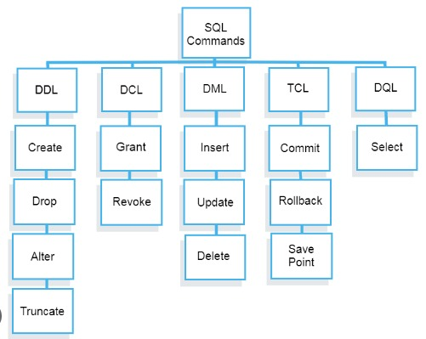
COMMONLY USED SQl STATEMENTS
DDL(Data Definition Language)
DML(Data Manipulation Language)
TCL(Transcation Control Language)
DCL(Data Control Language)
DQL(Data Query Language)

Slide 7

Project contents
Artist …
Artwork …
Gallery …
Contact …
Customer …

Slide 8
Er diagram...
ARTISTID
GID
ARTISTID
ARTID
EID
GID
ARTWORK
EID
CUSTID
ARTIST
YEAR
NAME
TYPE OF ART
LOC
GNAME
STYLE
GID
GALLERY
NAME
NAME
DOB
LOC
PHONE
CONTACT
CUSTOMER
Manage
GID
CUSTID
CUSTID

Slide 9
Schema diagram…
ARTIST
ARTWORK
Name
Artistid
Gid
Eid
Custid
Style
Loc
Artid
Artistid
Gid
Eid
Type of Art
year
GALLERY
Gname
Gid
Loc
CUSTOMER
CONTACT
Name
Custid
Gid
Dob
Name
Custid
Phone

Slide 10
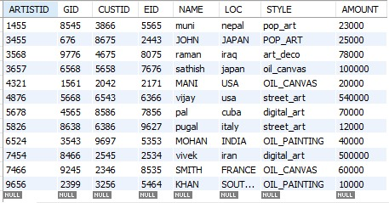
Queries…
WAQTD ALL THE DETAILS OF ARTIST.
Select * from artist;

Slide 11
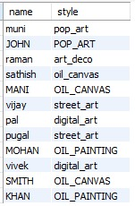
WAQTD NAME AND OF ALL THE ARTIST
select name,style from artist;

Slide 12

WAQTD THE DETAILS OF ARTIST WHOSE NAME IS PUGAL .
select * from artist where name='pugal';

Slide 13

WAQTD NAME AND LOC OF ARTIST STYLE OF POP_ART .
select name,loc artist where style='pop_art';

Slide 14

WAQTD NAME,LOC OF ARTIST IF THE LOC IRAN OR JAPAN .
select name,loc from artist where (loc='iran' or loc='japan');

Slide 15

WAQTD NAME,STYLE,LOC OF THE ARTIST STYLE AS STREET_ARTAND LOC IS USA
select name,loc,style from artist where STYLE='street_art'and loc='usa';

Slide 16

WAQTD DETAILS OF ARTIST WITH CUSTID 2545 OR 4675
select * from artist where custid in(2545,4675);

Slide 17

WAQTD ARTISTID,NAMEAND LOC OF ARTIST WHOSE ARTISTID IS 4321 OR 5678 AND EARNING MORE THAN 10000
select artistid,name,amount from artist where artistid in(4321,5678)and amount>10000;

Slide 18

WAQTD NAME OF STARTS WITH 'P' AND ENDS WITH 'L'
SELECT NAME FROM ARTIST WHERE NAME LIKE 'P%L';

Slide 19
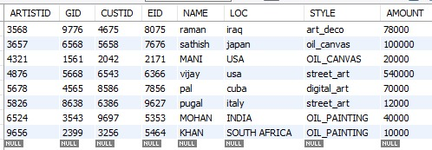
WAQTD NAME OF ARTIST HAVING NAMES 'A' IN THEIR .
select * from artist where name like "%A%";

Slide 20

WAQTD NAME OF ARTIST STYLE OF THE PUGAL
Select name from artist where style=(select style from artist where name='pugal');

Slide 21

WAQTD ALL THE DETAILS OF ARTIST DESIGN IN MANI AND LOC IS USA
select* from artist where style=(select style from artist where name='mani')and loc='usa';

Slide 22
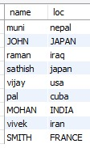
WAQTD NAME,LOC OF ARTIST IF THE ARTIST EARNING MORE THAN MANI
select name,loc from artist where amount>all(select amount from artist where name='mani');

Slide 23
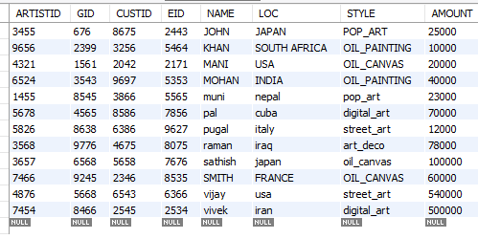
Waqtd the details of employe in acs?
SELECT * FROM artist ORDER BY NAME ASC;

Slide 24
Thank you…
Presented by
MANIPUGAL…

